Slide 1
Assets Review
In this you will look at each of my assets and give you thoughts and opinions.

Slide 2
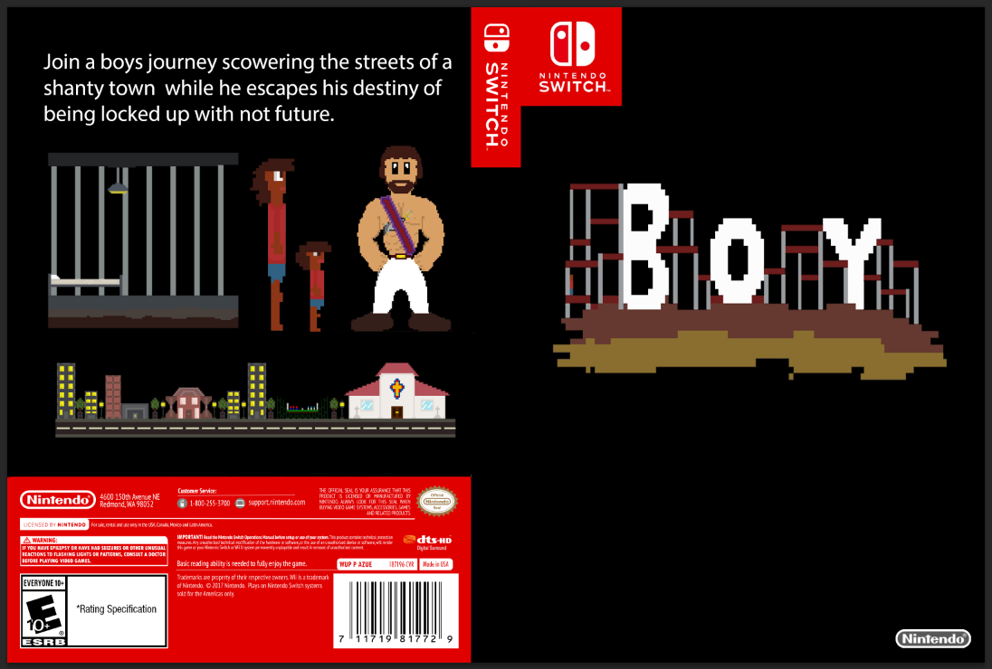
Do you like my promotional asset? It is a game case for the Nintendo Switch
Tom – Your case shows some of you assets very well but you could add more to the black background.
James – Yes, as it clearly shows the games title.

Slide 3
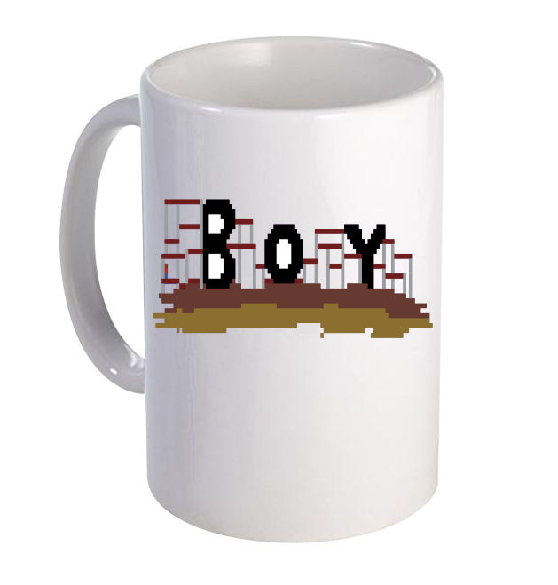
Do you like my promotional asset? It is a white mug with the games logo on it.
Tom – Yes.
James – Yes.

Slide 4
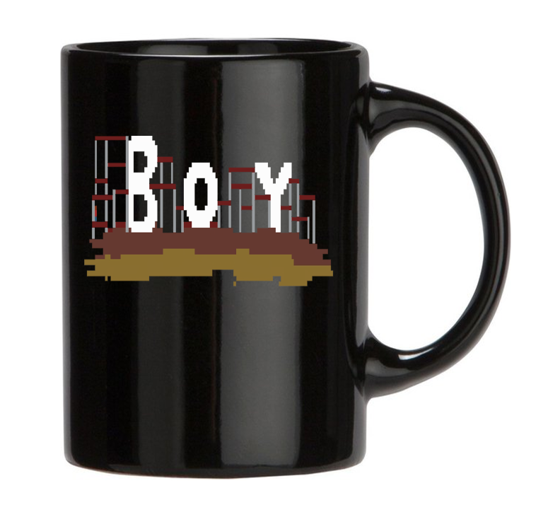
Do you like my promotional asset? It is a black mug with the games logo on it.
Tom – Yes.
James – Yes.

Slide 5
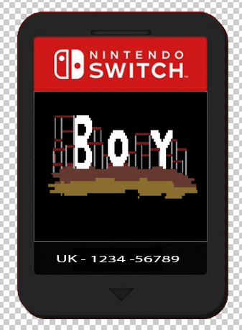
Do you like my promotional asset? It is a cartridge design of my game for the Nintendo Switch
Tom – Your cartridge design is simple but effective.
James - Yes.

Slide 6
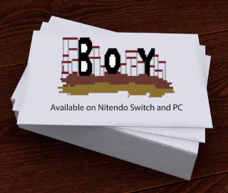
Do you like my promotional asset? It is a business card with my games logo on it.
Tom – It could use more information on it, explaining what you do.
James - useless

Slide 7
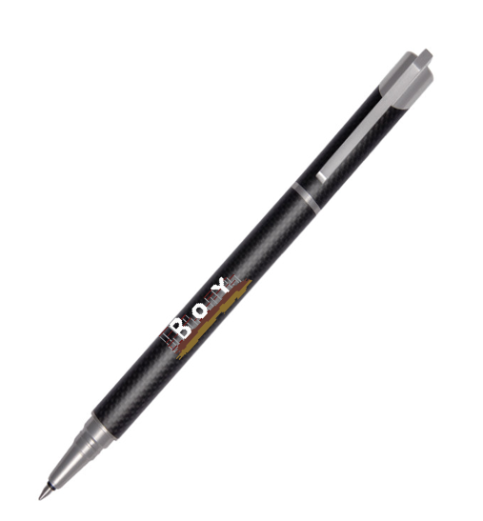
Do you like my promotional asset? It is a black pen with the games logo on it.
Tom – Yes.
James – Yes.

Slide 8
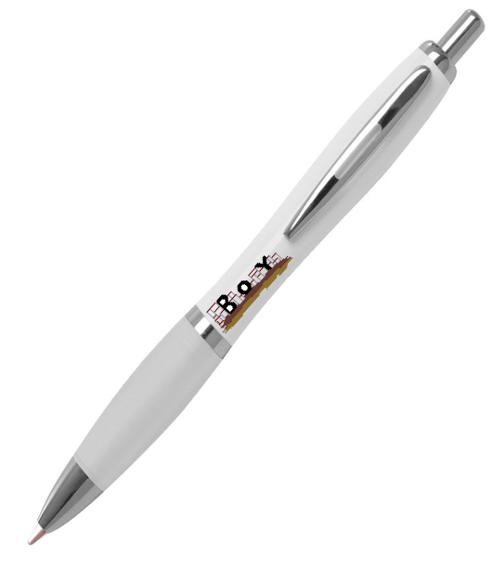
Do you like my promotional asset? It is a white pen with the games logo on it.
Tom – Yes.
James – Yes.

Slide 9
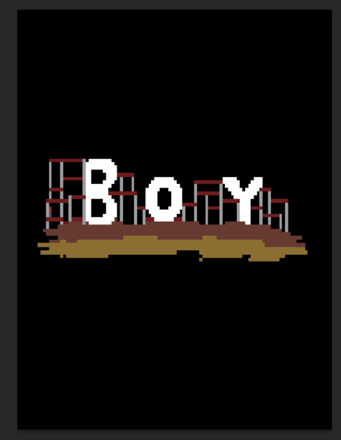
Do you like my promotional asset? It is a poster with the games logo on it.
Tom – Yes.
James - Yes.

Slide 10
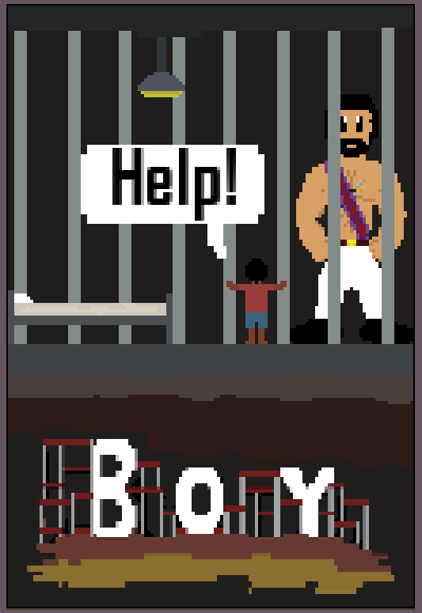
Do you like my promotional asset? It is a poster for my game.
Tom – The poster does give me an idea of what the game may be about. However the artwork on the child could be improved by increasing his size.
James - Decent

Slide 11
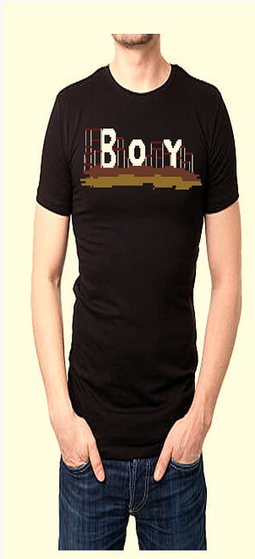
Do you like my promotional asset? It is a t-shirt with the games logo on it.
Tom – Yes.
James – Yes.

Slide 12
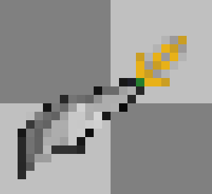
Do you like my game asset? It is a sword which will be held by the guard.
Tom – I like the hilt design but the shading on the blade could be improved.
James – Yes.

Slide 13
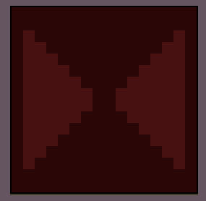
Do you like my game asset? It is a tile which will be used to make the map of my game.
Tom – Yes.
James – It is ok.

Slide 14
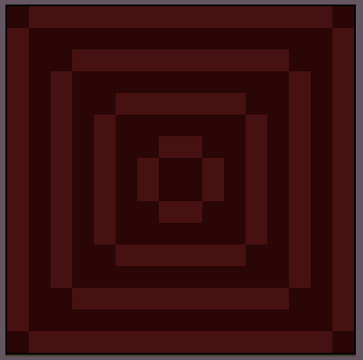
Do you like my game asset? It is a tile which will be used to make the map of my game.
Tom – Yes.
James – It is ok.

Slide 15
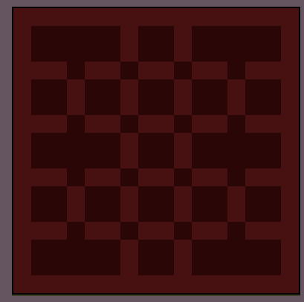
Do you like my game asset? It is a tile which will be used to make the map of my game.
Tom – Yes.
James - It is ok.

Slide 16
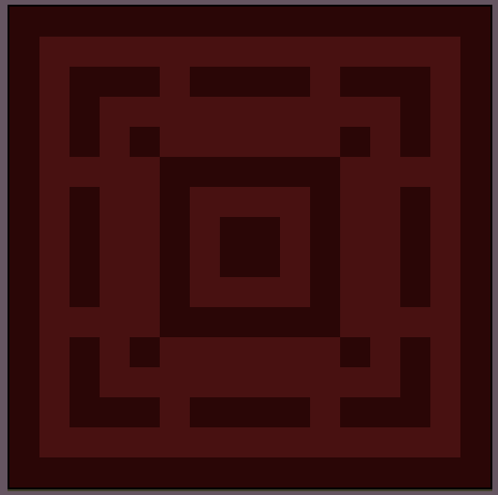
Do you like my game asset? It is a tile which will be used to make the map of my game.
Tom – Yes.
James - It is ok.

Slide 17
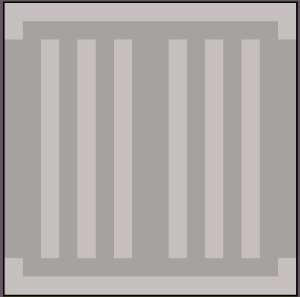
Do you like my game asset? It is a tile which will be used to make the map of my game.
Tom – Yes.
James - It is ok.

Slide 18
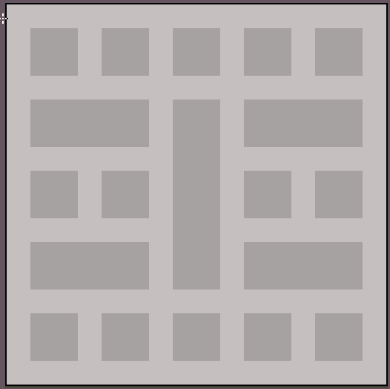
Do you like my game asset? It is a tile which will be used to make the map of my game.
Tom – Yes.
James - It is ok.

Slide 19
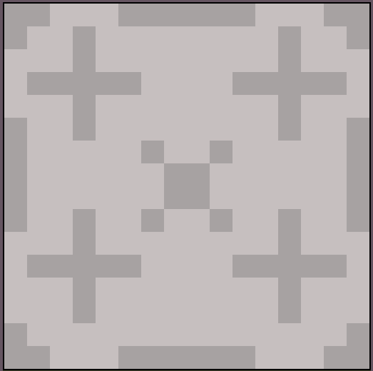
Do you like my game asset? It is a tile which will be used to make the map of my game.
Tom – Yes.
James - It is ok.

Slide 20
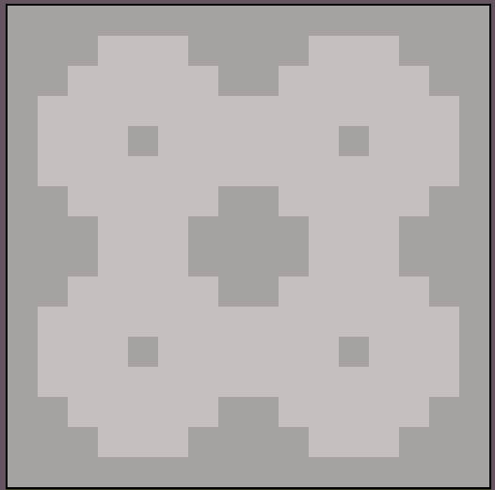
Do you like my game asset? It is a tile which will be used to make the map of my game.
Tom – Yes.
James - It is ok.

Slide 21
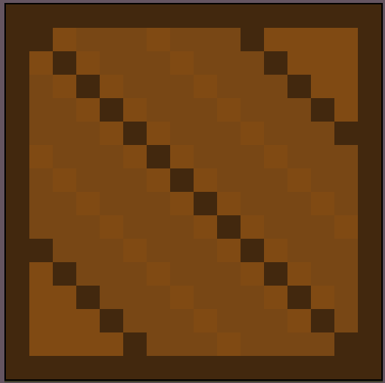
Do you like my game asset? It is a tile which will be used to make the map of my game.
Tom – Yes.
James – It is ok.

Slide 22
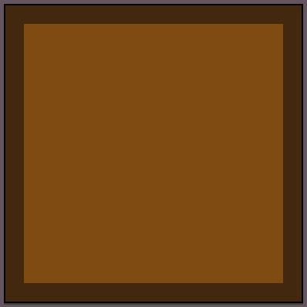
Do you like my game asset? It is a tile which will be used to make the map of my game.
Tom – Yes.
James – It is ok.

Slide 23
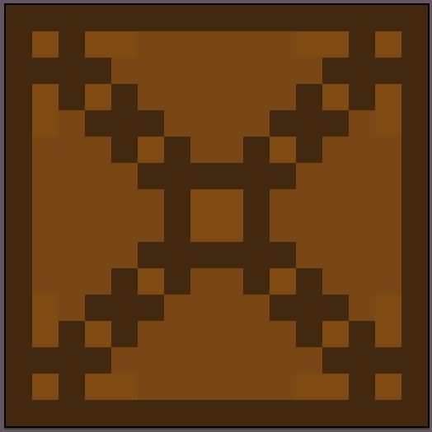
Do you like my game asset? It is a tile which will be used to make the map of my game.
Tom – Yes.
James – It is ok.

Slide 24
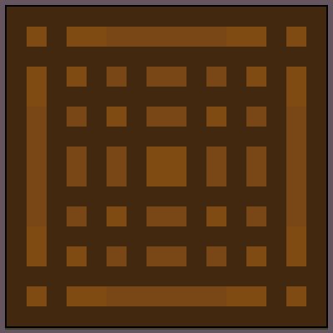
Do you like my game asset? It is a tile which will be used to make the map of my game.
Tom – Yes.
James – It is ok.

Slide 25
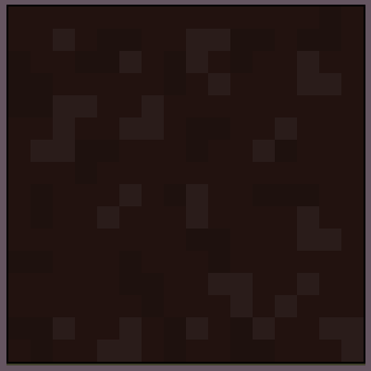
Do you like my game asset? It is a tile which will be used to make the map of my game.
Tom – Yes.
James – It is ok.

Slide 26
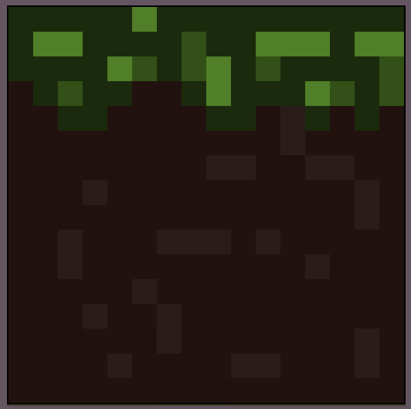
Do you like my game asset? It is a tile which will be used to make the map of my game.
Tom – Yes.
James – It is ok.

Slide 27
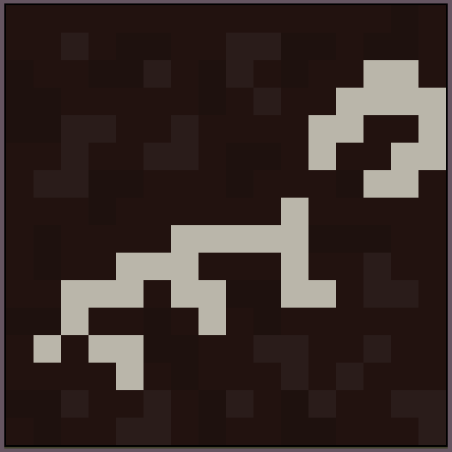
Do you like my game asset? It is a tile which will be used to make the map of my game.
Tom – Yes.
James – It is ok.

Slide 28
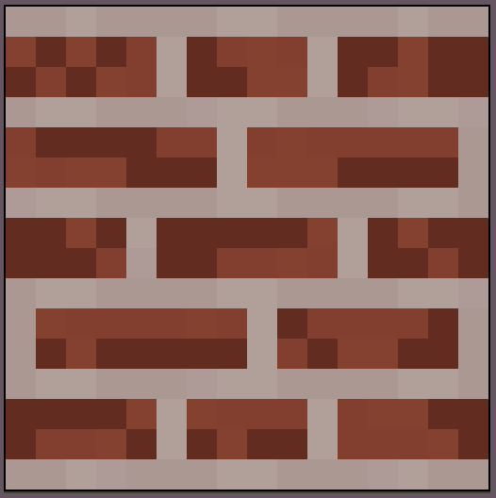
Do you like my game asset? It is a tile which will be used to make the map of my game.
Tom – Yes.
James – It is ok.

Slide 29
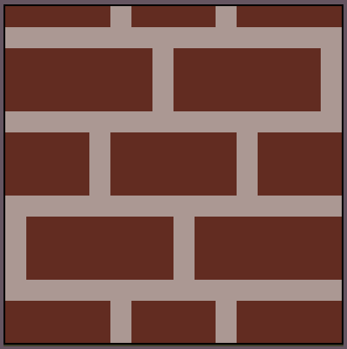
Do you like my game asset? It is a tile which will be used to make the map of my game.
Tom – Yes.
James – It is ok.

Slide 30
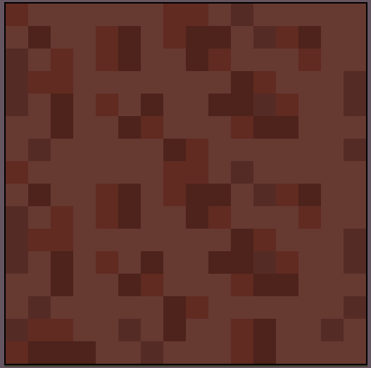
Do you like my game asset? It is a tile which will be used to make the map of my game.
Tom – Yes.
James – It is ok.

Slide 31
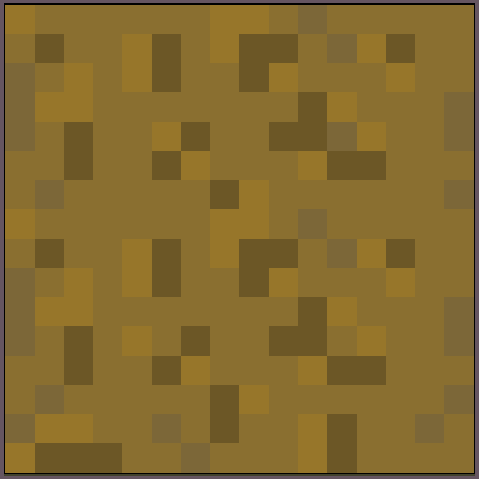
Do you like my game asset? It is a tile which will be used to make the map of my game.
Tom – Yes.
James – It is ok.

Slide 32
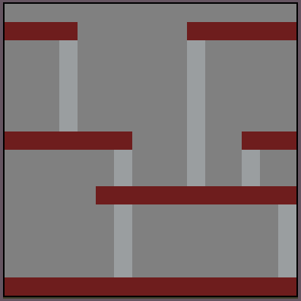
Do you like my game asset? It is a tile which will be used to make the map of my game.
Tom – Yes.
James – It is ok.

Slide 33
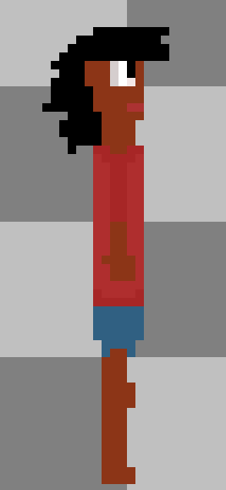
Do you like my game asset? It is the main/playable character grown up.
Tom – It is a clear design but could have some more detail.
James – Yes.

Slide 34
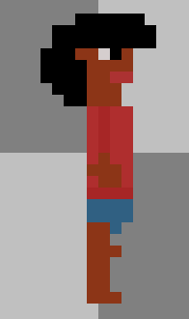
Do you like my game asset? It is the main/playable character from the start of the game when he is young.
Tom – Yes.
James – It is ok.

Slide 35
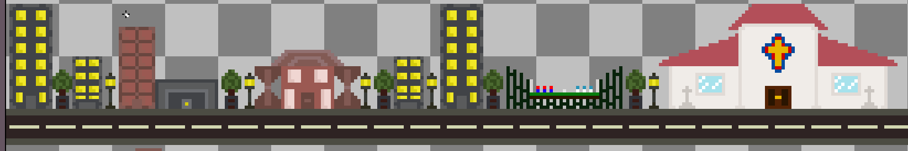
Do you like my game asset? It is a playable map in the game.
Tom – The map size may need to be increased and have a few more buildings added. But it is a good concept.
James - Yes.

Slide 36
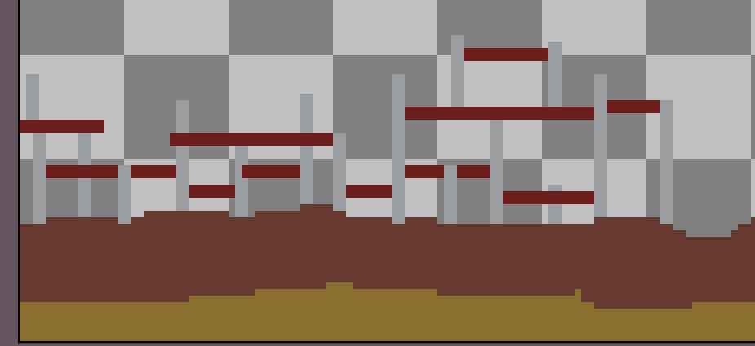
Do you like my game asset? It is a playable map in the game.
Tom –
James -

Slide 37
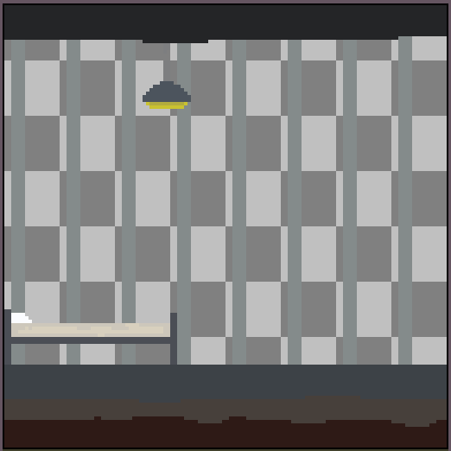
Do you like my game asset? It is a playable map in the game.
Tom – Yes.
James – It is ok.

Slide 38
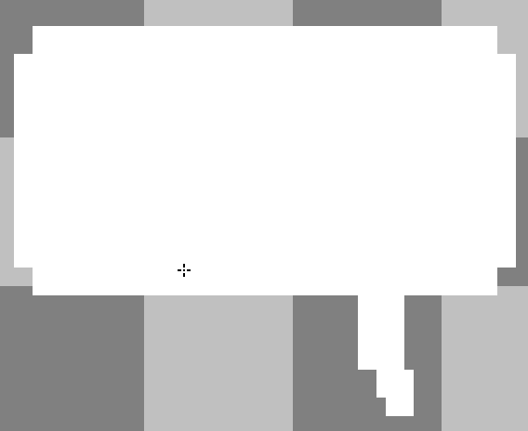
Do you like my game asset? It is a speech bubble and will be used to display text in my game.
Tom – Yes.
James – It is ok.

Slide 39
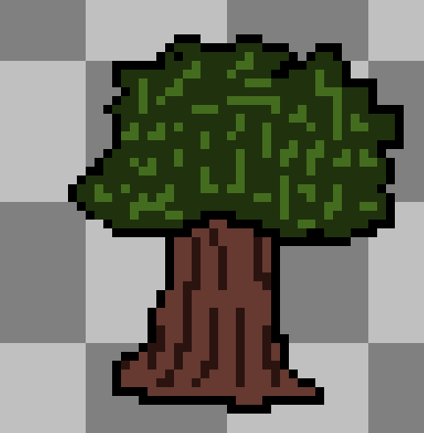
Do you like my game asset? It is a tree and will be placed in the background.
Tom – Yes.
James – It is ok.

Slide 40
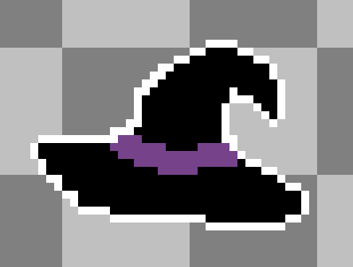
Do you like my game asset? It is a wearable hat for the main character.
Tom – Yes.
James – It is ok.

Slide 41
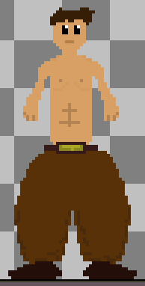
Do you like my game asset? It is an enemy which the player will have to fight/avoid.
Tom – Yes.
James – It is ok.

Slide 42
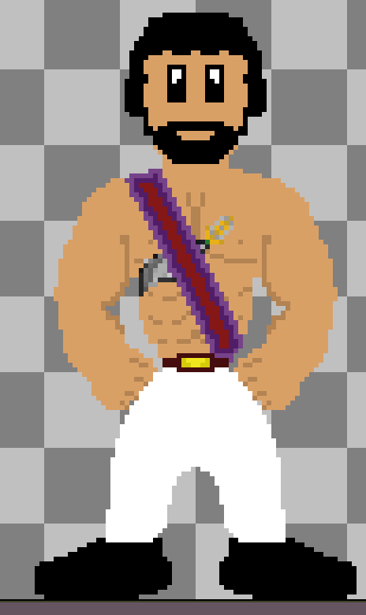
Do you like my game asset? It is an enemy which the player will have to fight/avoid.
Tom – Yes.
James – It is ok.

